Slide 1

AI in FinTech
By MXK

Slide 2
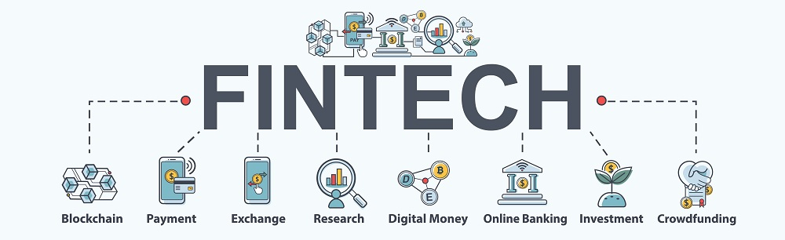

Slide 3
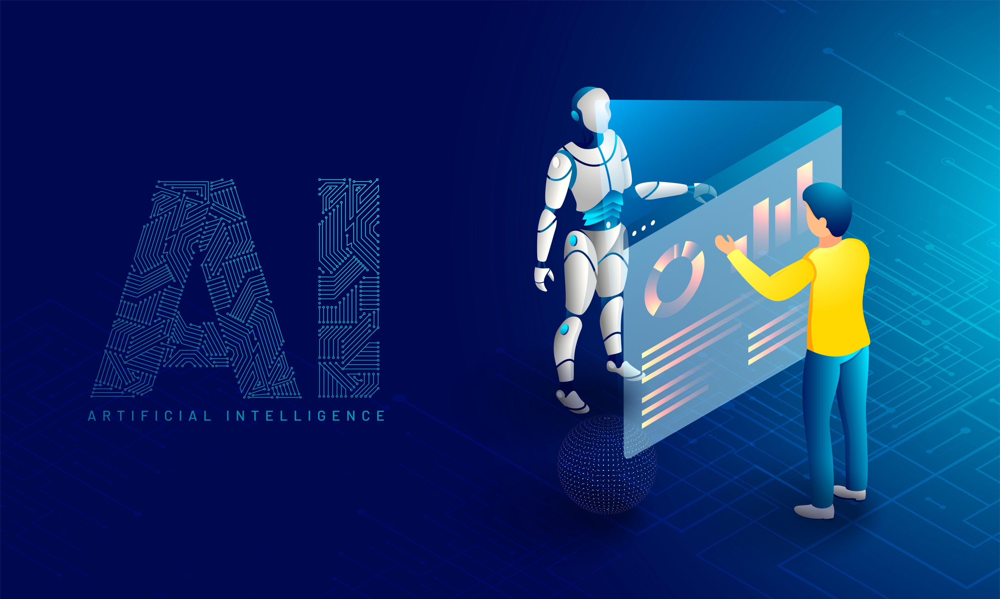

Slide 4


Slide 5
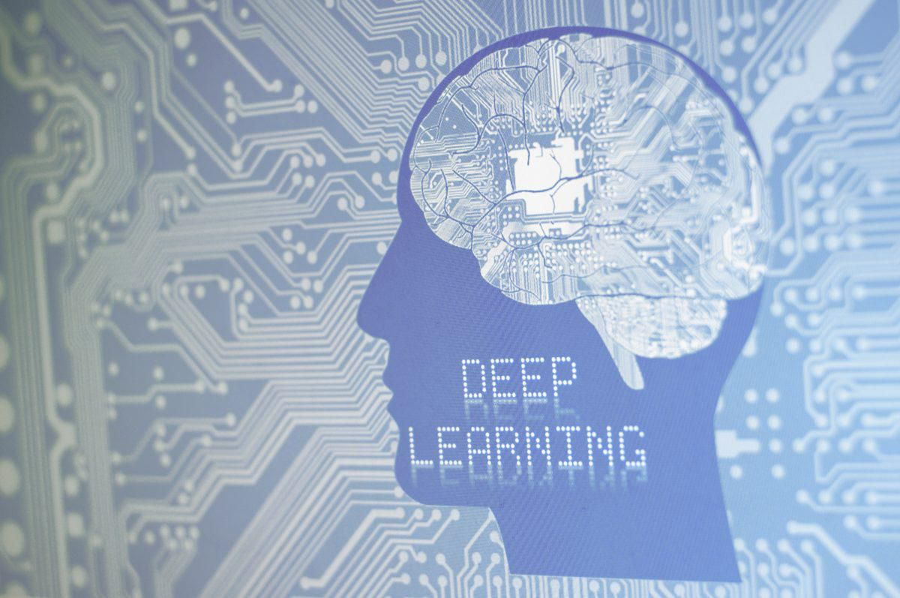

Slide 6


Slide 7
Thank You
Q & A

